Slide 1
Projection Mapping Show control

Slide 2
Inspiration

Slide 3
Projection Mapping
Projection mapping is the art of liberating video content from the confines of flat screens.
By transforming irregular surfaces—such as buildings, objects, or stages—into dynamic video displays, we can create the illusion that these objects are moving, changing shape, or coming to life.

Slide 4
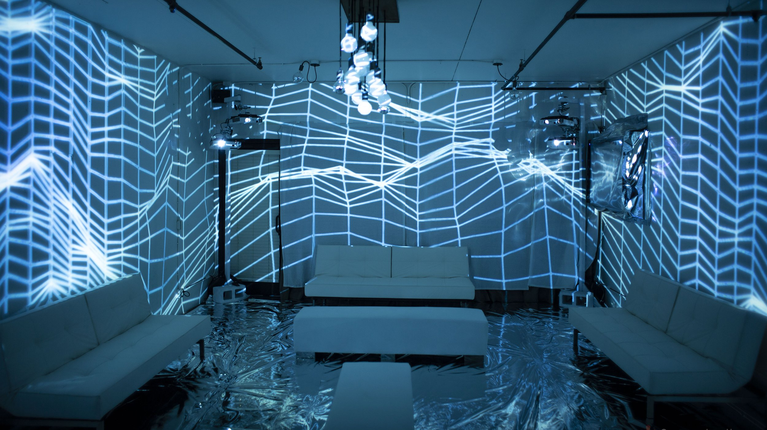

Slide 5
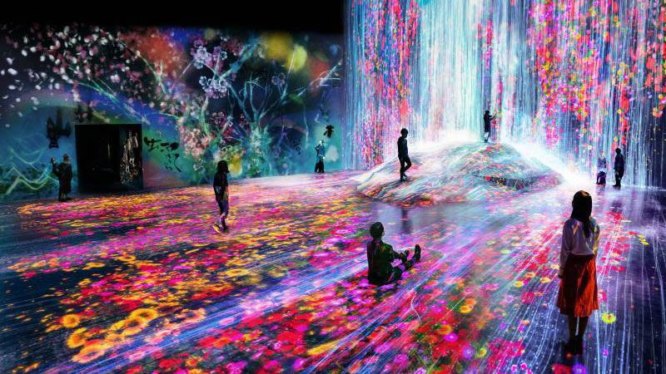

Slide 6
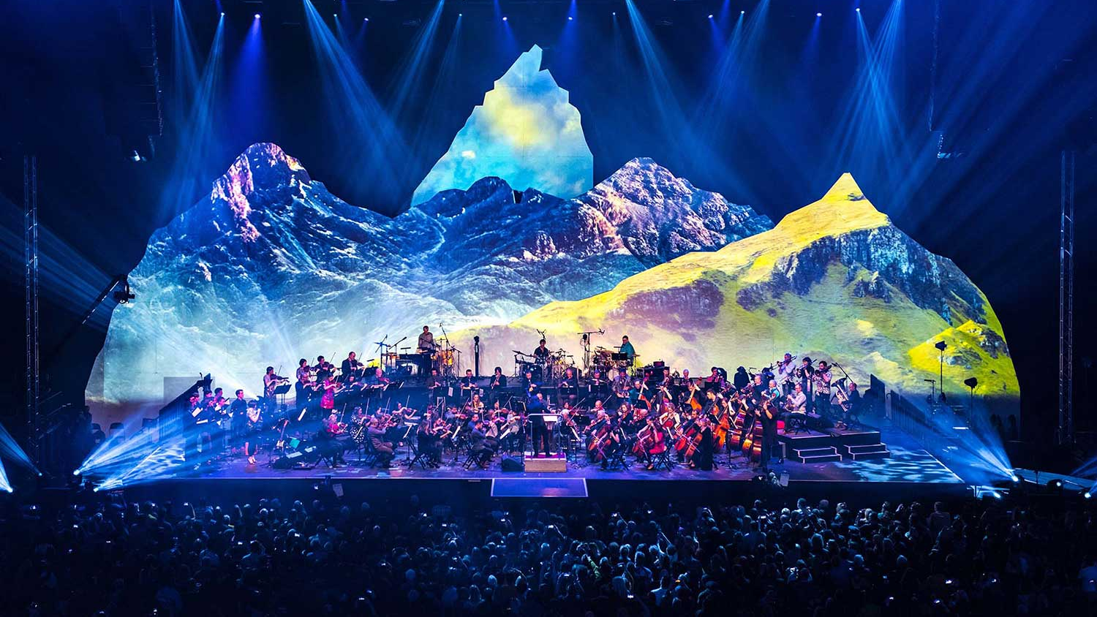

Slide 7
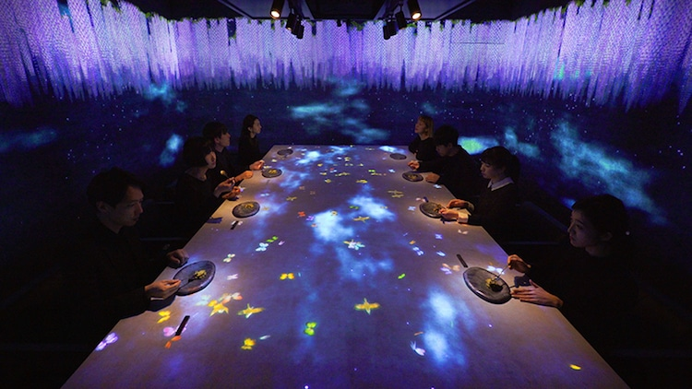

Slide 8
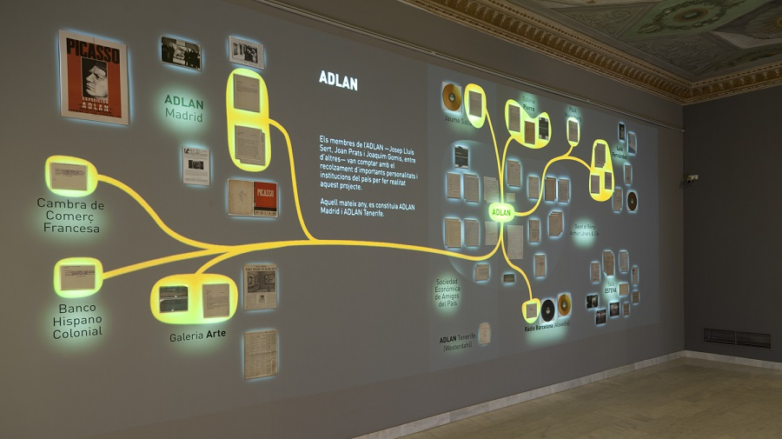

Slide 9
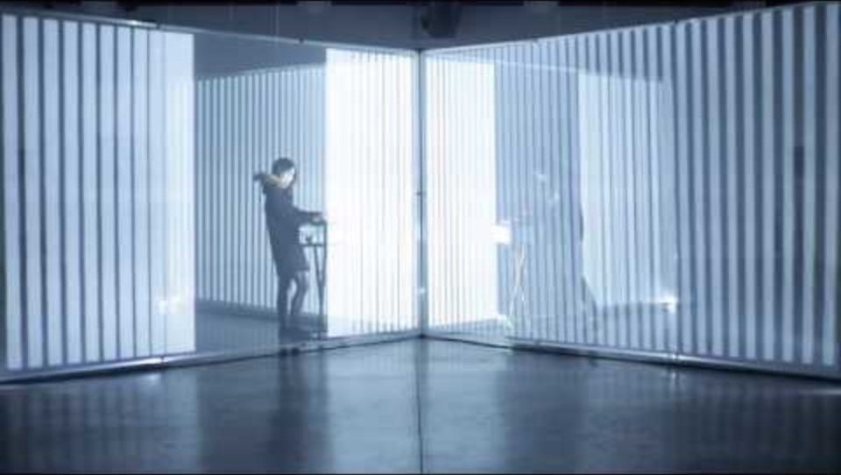

Slide 10
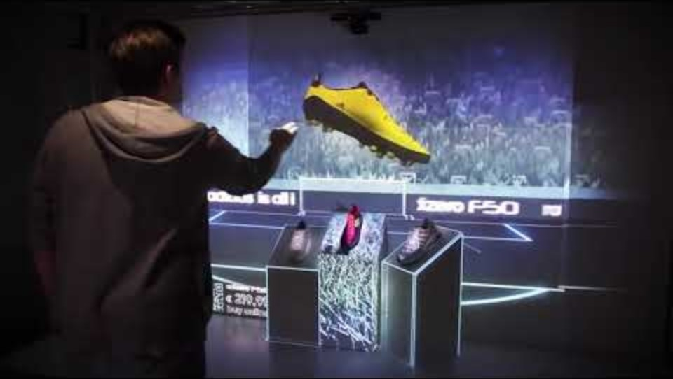

Slide 11
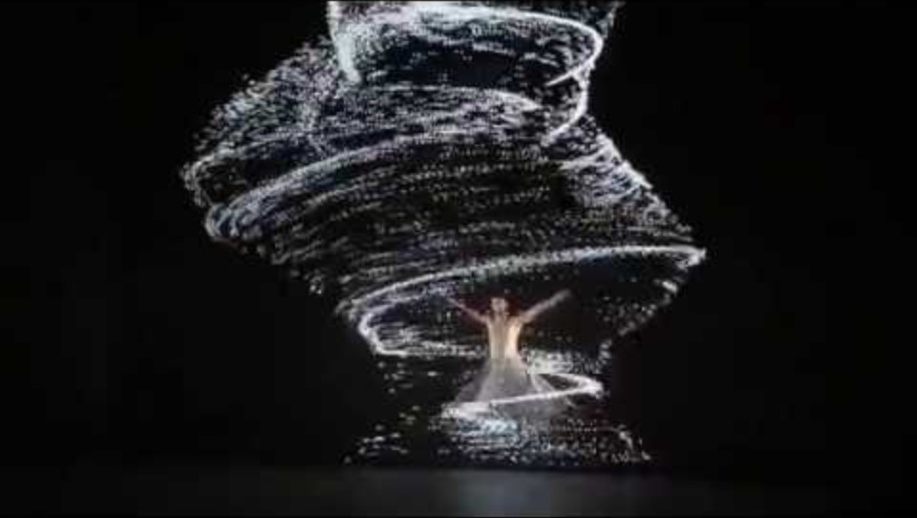

Slide 12
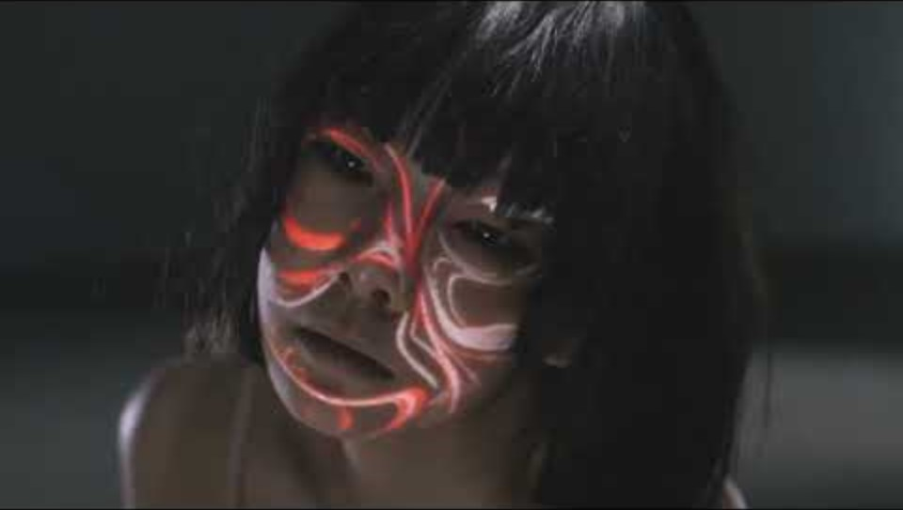

Slide 13
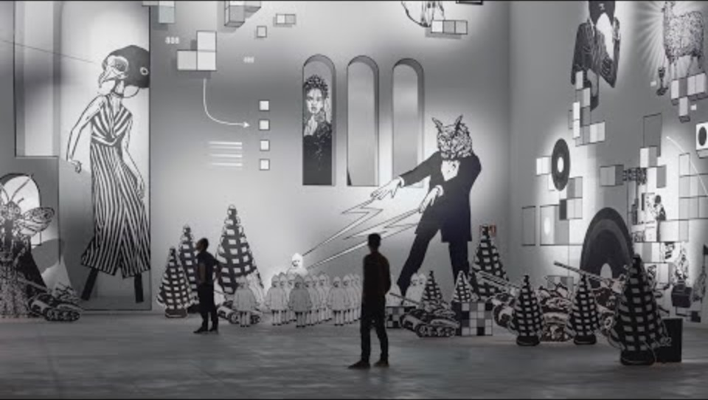
Notes:
Mécaniques Discursives by Fred Penelle & Yannick Jacquet - Laboral Centro de Arte - LEVFestival 2021

Slide 14
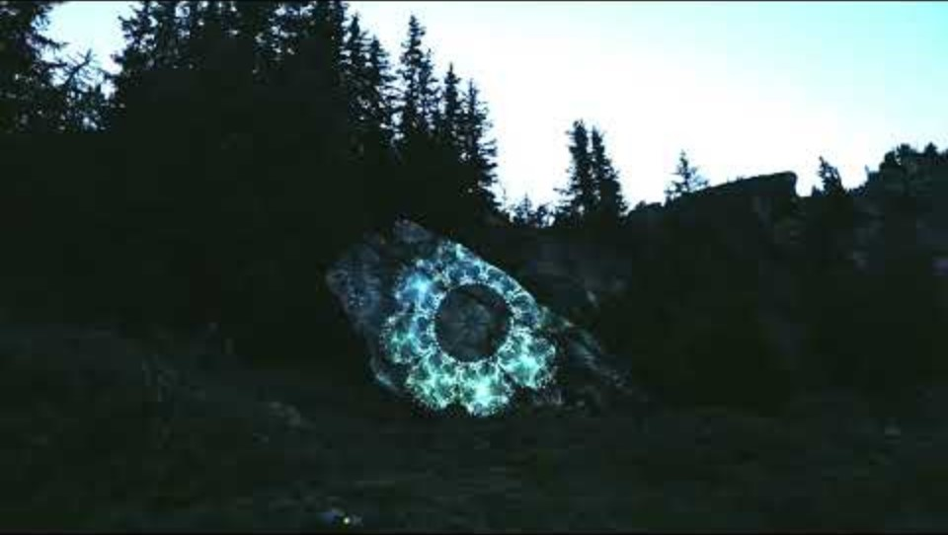

Slide 15


Slide 16
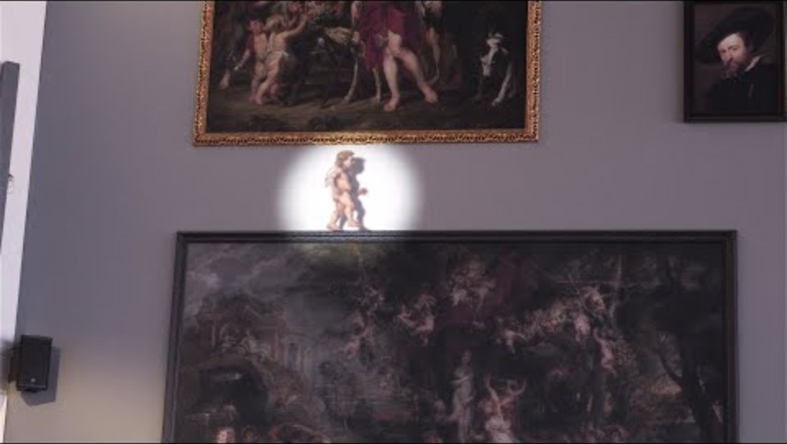

Slide 17
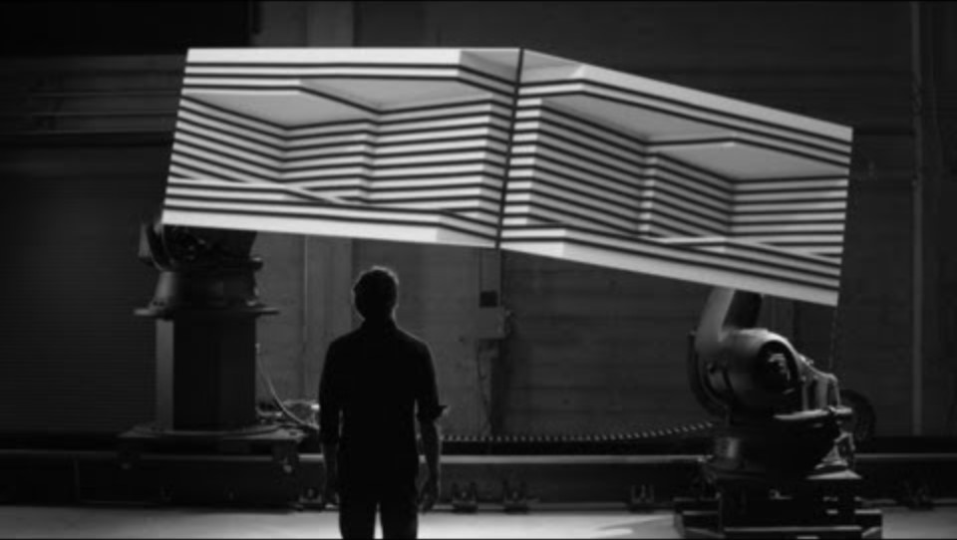

Slide 18
Show Control

Slide 19
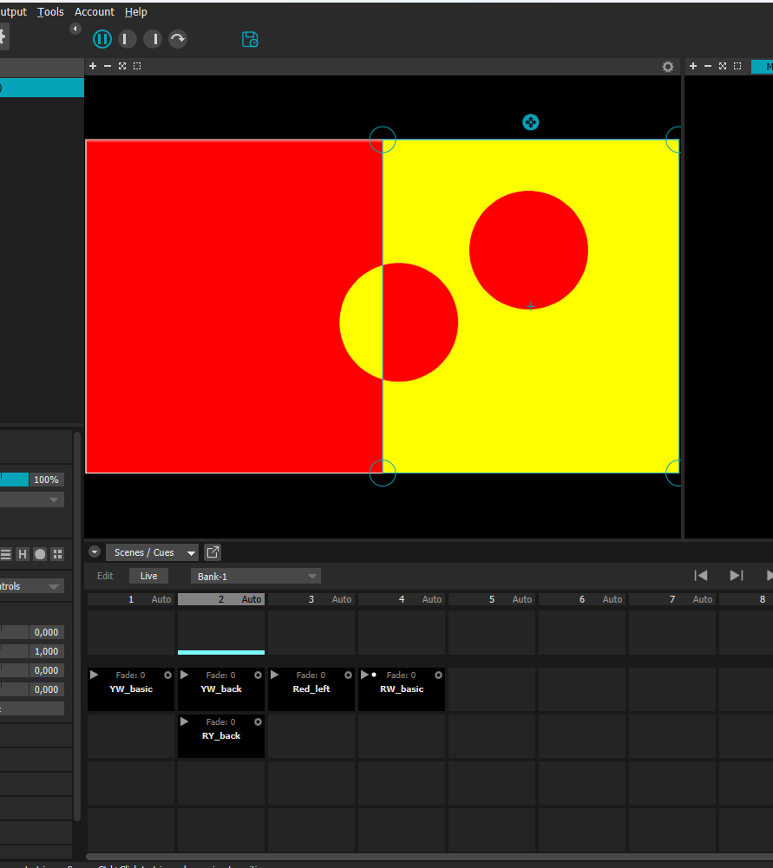
Scenes/Cues
Scenes:
Scenes record all MadMaper parameters on a given moment.
Cues:
Cues record specific parameters.
You can trigger a scene/cue by clicking on it.
You can trigger all cues on a column by clicking on the column

Slide 20
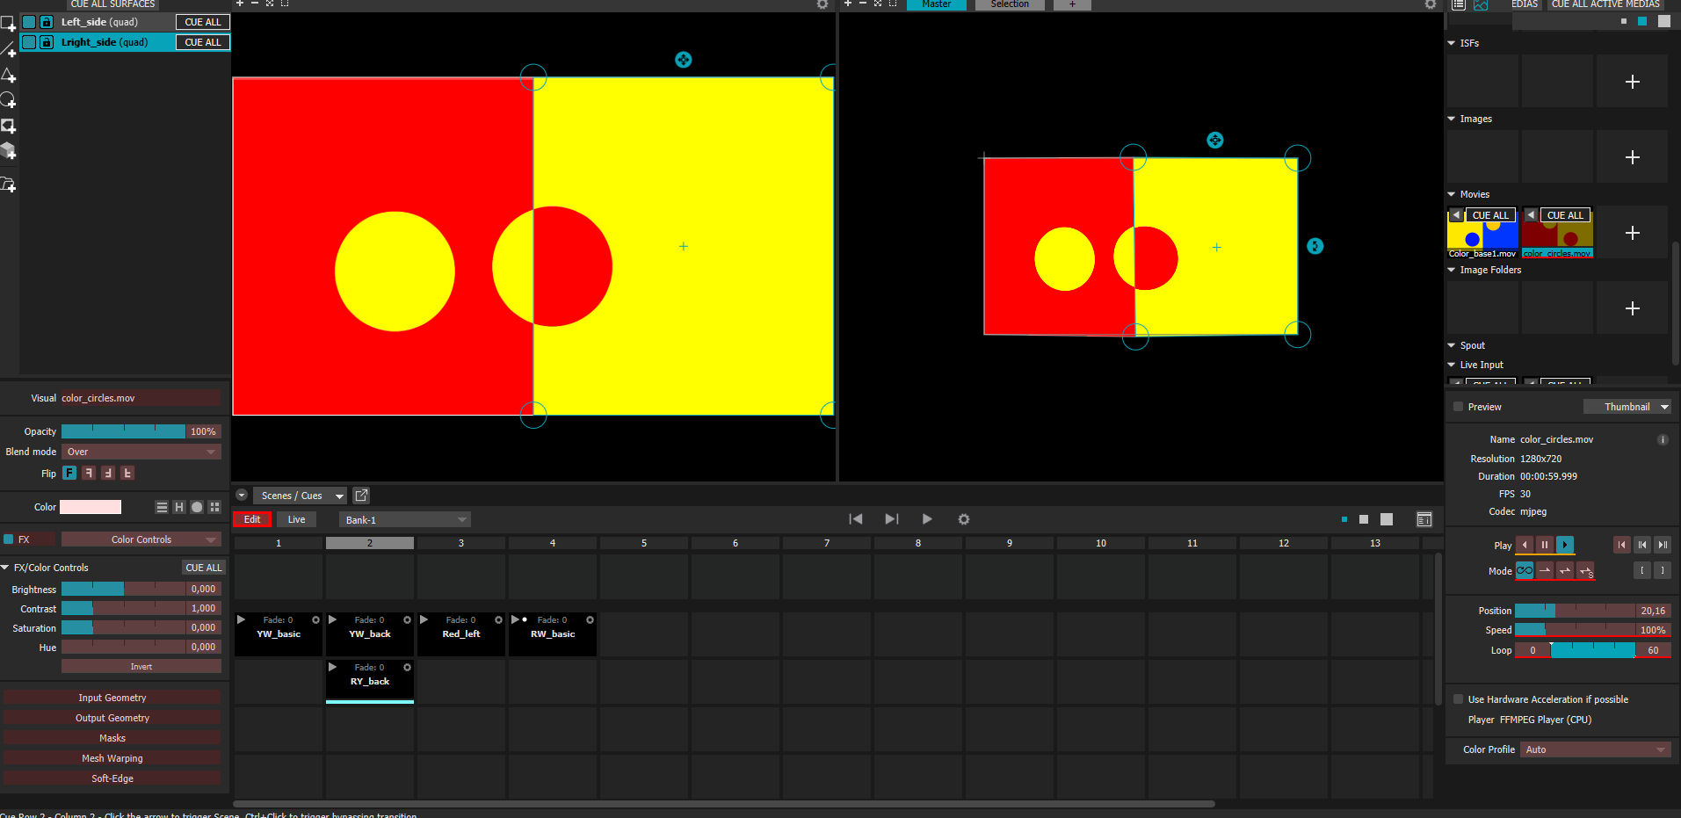
Look back
Edit Button allows you see what parameters are on a scene or cue.

Slide 21
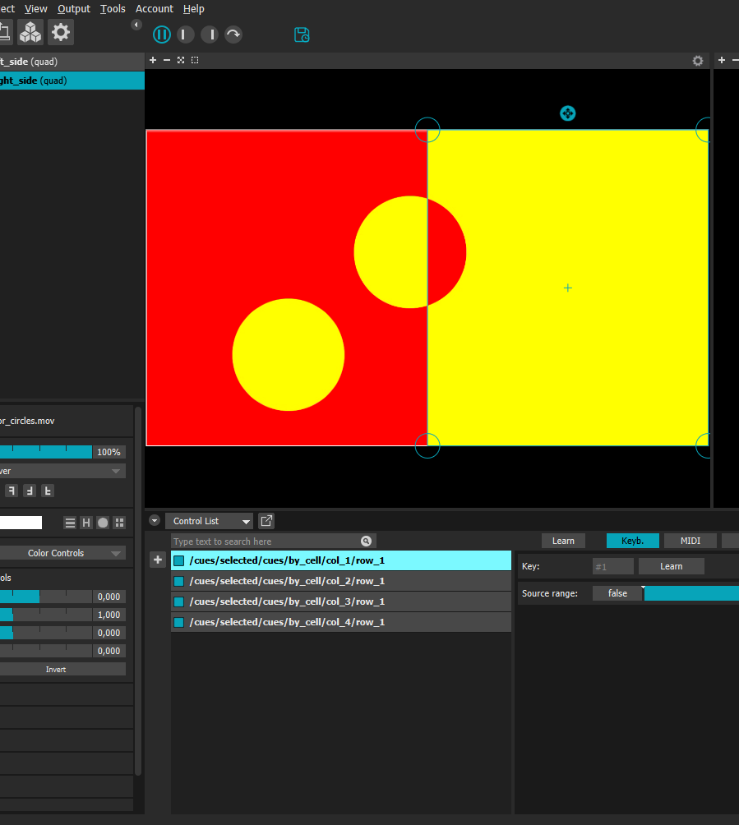
Keyboard
You can link cues and scenes to keyboard keys.
Left click on a scene/cue and then on add control -keyboard

Slide 22
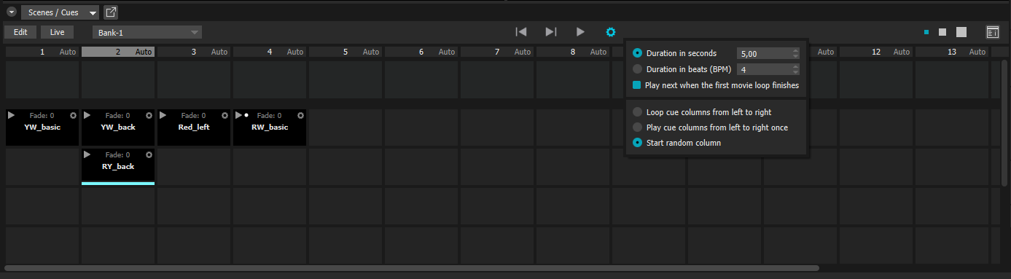
Scheduling
You can play all columns in a sequence by selecting it on the play area.

Slide 23
Challenge

Slide 24
Challenge 2
Make a 1 to 2-minute projection mapping show.
Use at least four different types of controls that change the projections in the show.
Present on 15:00
Tip: Keep the mapping simple

Slide 25

Thank you

